Slide 1


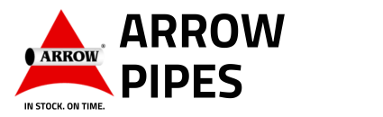
Technical Commercial Document for :- Arrow Pipes AI Application Modules Development
Cylsys, Mumbai. Sep 2025
4 / 8 / 2 0 2 5
1

Slide 2
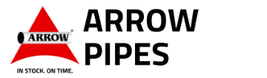

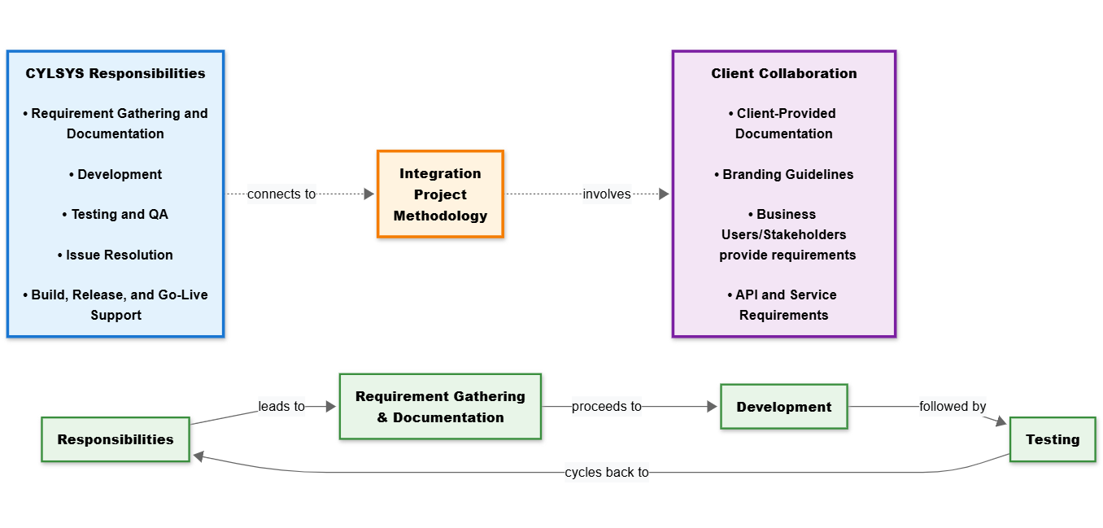
Integration Project Methodology and Responsibilities
Cylsys will be responsible for the full development of the CRM application, handling all aspects of the system design, backend development, and API integration. However, the client team will collaborate closely with Cylsys on specific tasks and work items.
This collaborative approach will ensure a robust and effective solution, meeting the client’s needs efficiently and
transparently.

Slide 3

Executive Summary – Arrow Pipes CRM + Azure AI Solution
Challenges at Arrow Pipes:
- Manual enquiry → quote delays (2–3 days)
- No AI insights → pricing & compliance errors
- Manual follow-ups → low engagement
- Limited reporting → no real-time view
Our Solution:
- Azure AI-powered CRM integrated with ERP
- Automated quotations, compliance validation, proactive follow-ups
- WhatsApp Bot for 24×7 customer service
Business Outcomes:
- Quote TAT reduced from 2–3 days → few hours
- Win-rate +15–20%
- 90% fewer compliance/document errors
- Real-time dashboards → better decisions

Slide 4
Challenges at Arrow Pipes:
Manual Enquiry → Quote Delays (2–3 days)
Currently, enquiries received via email are processed manually.
Each request requires manual classification, SKU mapping, stock verification, and quotation preparation.
This results in turnaround times of 2–3 working days, which delays client responses and increases the chances of losing business to faster competitors.
No AI Insights → Pricing & Compliance Errors
Quotation pricing is heavily dependent on manual lookups and historical references.
Without AI-based validation, errors occur in MTC (Material Test Certificates), CoC, and compliance documents.
Inconsistent pricing and compliance gaps reduce credibility and can also lead to financial loss or regulatory risks.

Slide 5
Challenges at Arrow Pipes:
Manual Follow-ups → Low Customer Engagement
Sales teams are manually sending follow-ups through emails or calls.
Inconsistent tracking means some leads are over-contacted while others are completely missed.
This leads to poor client experience, lower conversion ratios, and missed upsell opportunities.
Limited Reporting → No Real-Time View
Current reporting relies on Excel sheets and scattered data, which lacks centralization.
Management cannot view real-time performance dashboards for pipeline, conversion rates, TAT, or customer satisfaction.
Decisions are reactive instead of proactive, resulting in reduced efficiency and delayed corrective action.

Slide 6
Our Solution
Azure AI-Powered CRM Integrated with ERP
A next-generation Customer Relationship Management (CRM) platform built on Azure Cloud and seamlessly integrated with Arrow Pipes’ existing ERP system.
Enables real-time data exchange between sales, inventory, pricing, and compliance functions.
Azure AI services (OCR, NLP, Cognitive Search, Machine Learning) power intelligent document validation, enquiry classification, and demand forecasting.
Provides a centralized dashboard for management with live KPIs, pipeline tracking, and predictive insights.
Automated Quotations, Compliance Validation, and Proactive Follow-ups
Quotations generated automatically using pricing engines linked to raw material indices (LME/SME) and SKU composition rules.
Built-in compliance engine validates critical documents such as Material Test Certificates (MTCs), Certificates of Compliance (CoC), and QA records using OCR + AI.
Follow-ups automated via CRM workflows, ensuring timely reminders, consistent communication, and higher conversion ratios.
Reduction in manual errors, improved speed, and standardized approval workflows across the organization.

Slide 7
Business Outcomes
Quote Turnaround Time (TAT) Reduced from 2–3 Days → Few Hours
With AI-powered enquiry parsing, automated SKU mapping, and real-time ERP integration, the quotation process that earlier took 2–3 business days can now be completed within a few hours.
This speed positions Arrow Pipes ahead of competitors, increasing customer satisfaction and improving the chances of winning time-sensitive deals.
Win-Rate Improved by +15–20%
Faster responses, accurate pricing, and structured follow-ups significantly enhance customer trust.
Automated lead nurturing ensures no potential client is left unattended.
Together, these improvements can boost conversion rates from the current 25–30% to 40–50%, directly contributing to higher revenue.

Slide 8
Business Outcomes
90% Fewer Compliance/Document Errors
AI-driven OCR and validation mechanisms ensure that MTCs, CoCs, QA certificates, and shipping documents are automatically verified against compliance rules.
This minimizes human error, reduces the risk of audit failures, and builds confidence among regulatory bodies and clients.
Fewer document errors also mean smoother project execution and reduced back-and-forth with customers.
Real-Time Dashboards for Better Decision-Making
A centralized dashboard provides live insights into enquiries, quotations, pipeline status, win-loss ratios, inventory, and customer engagement metrics.
Managers gain the ability to make data-driven, proactive decisions instead of relying on delayed Excel reports.
Predictive analytics further help in demand forecasting, pricing strategies, and resource planning.

Slide 9
Scope of Work
Arrow seeks a robust, modular ERP/CRM ecosystem to streamline enquiries → quotes → delivery, improve lead handling, automate follow-ups, and strengthen customer engagement via WhatsApp. The solution will reduce quote TAT, raise win-rates, ensure audit-ready documentation, and provide measurable KPIs for continuous improvement.
1.CRM Application (i) Enquiry Module
(ii) Global Inventory Setup
(iii) Price Estimation Module
(iv) Follow-up Module
(v) Survey/Feedback Module

Slide 10
What you will get
1.Web Pages
40-45 app development screens for Desktop and smart devices.
2. API Integrations
API (Application Programming Interface) Integration enables your application to connect with external services, applications, or systems to exchange data and enhance functionality. Whether it’s a CRM,ERP, whats app bot or third-party database, APIs streamline operations and improve user experience. 3. Database Design
Structured and scalable database architecture to store all site data including user information, program content, form submissions, and admin configurations.
4. Database Integration
Connecting the frontend interface with the backend database to enable real-time data flow between the user interface and the server, ensuring accurate data retrieval and storage.

Slide 11
What you will get
5. Testing and Security
Functional, Automation, and Compatibility Testing
Data Validation & XSS/SQL Injection Protection
HTTPS Enforcement & SSL Setup
6 Browser & Device Compatibility Testing
Verifying the website’s look and performance across multiple browsers and devices to ensure uniform behavior and appearance.
7. Performance Optimization
Optimizing page load speed, reducing server requests, and compressing assets (images, CSS, JavaScript) for smooth and fast user experience.
8. Hosting Setup
Hosting, SSL, Domain Setup, DNS Configuration

Slide 12
What you will get
9. SSL Certificate
Installing a Secure Sockets Layer (SSL) certificate to enable HTTPS and encrypt user data during transmission for secure communication.
10. SSL Security Configuration and Integration
Configuring the server and website to enforce HTTPS across all pages, enhancing data security and user trust. It will also redirect all the requests coming from http to https.
11. Data Validation and Sanitization
Implementing backend and frontend checks to ensure that all user-submitted data is clean, valid, and free from malicious content to protect against XSS and SQL injection attacks.

Slide 13
System Architecture
User Interface Layer │ │ (Web Portal, APIs)
Application Services Layer
CRM Application
Module
User Management
Approval Flows
Others
AI & ML Services Layer │ │ (NLP, OCR, Recommendation Engine, Pricing Engine)
Integration Layer │ │ (ERP Connector, API Management, Message Queue)
Data Layer │ │ (Primary DB, Document Store, Cache, Data Warehouse)

Slide 14
Technology Stack
Backend Services:
Framework: .NET
Alternative: Node.js with TypeScript 5.0+ for real-time services
Database: SQL 15+ (Primary), Redis 7+ (Cache/Session)
Message Broker: Apache Kafka 3.5+
API Gateway: Azure and ERP APIs
Frontend Applications:
Web: MVC .NET,
UI Framework: Material-UI / Figma
DevOps & Infrastructure:
Containerization: Docker 24+, Kubernetes 1.28+(if applicable)
Cloud Platform: Azure
CI/CD: GitLab CI / GitHub Actions
Third-Party Integrations:
WhatsApp: Meta WhatsApp Business API
Email: O365
SMS: Twilio /Others
File Storage: Internal storage / Azure Blob Storage
Note – we are planning to use above tech on the Project, but tech stack can be changed according to the availability and requirement of the solution.

Slide 15
Enquiry Module –Technical Overview
Category | Details
Key Features | - Omni-channel enquiry capture (Email / WhatsApp / Tenders) - Auto-triage & classification by customer type - SKU normalization & specification matching - MTC / deviation checks - Inventory intelligence (on-hand, expiring, incoming) - Dashboards for: • Enquiry → Offer • Offer → Order • Turnaround Time (TAT) • Fill-rate
Technical Components | - OCR / NLP Enquiry Parser → Extract structured data from documents & messages - SKU Crosswalk Engine → Map equivalent SKUs across vendors/customers - Compliance Governance → AVL, Origin, CoO checks - ERP Integration → Seamless sync with backend systems - Offer Pack Generator → Auto-generate offer documents - Approval Bot → Automated workflow for internal approvals

Slide 16
Global Inventory Setup – Technical Overview
Category | Details
Key Features | - ERP stock check with vendor fallback (via APIs / emails)
 | - Auto-request vendor inventory when internal stock is insufficient
 | - MTC & Deviation attachments for compliance
 | - Multi-vendor comparison (commercial & technical fit)
 | - Auto-alerts when own stock is low
Technical Components | - Vendor Database → SKU, stock, lead time, pricing records
 | - ERP Sync → Real-time integration with ERP for stock validation
 | - Vendor Integrations → API / email connectors for inventory updates
 | - Auto-Sync Inventory Levels → Continuous update of available quantities from ERP + vendors

Slide 17
Price Estimation Module – Technical Overview
Category | Details
Key Features | - Automated SKU pricing from composition + raw material (RM) prices
 | - Margin rules & discount structures
 | - Price history tracking
 | - Competitive offer generation
 | - Analytics dashboards for pricing insights
Technical Components | - APIs to LME/SME → Fetch live raw material prices
 | - SKU Composition Database → Define % composition for each SKU
 | - Conversion Cost Tables → Standardized cost additions
 | - Pricing Calculation Engine → Formula: Σ(Composition % × RM Price) + Conversion Cost
 | - ERP / CRM Integration → Seamless pricing sync across systems
 | - Export Options → Excel / PDF reports
 | - AVL & Geography Checks → Compliance with approved vendor lists and regional restrictions

Slide 18
Buy Back Module – Technical Overview
Category | Details
Key Features | - Link buyback requests to original enquiry/order (if Arrow-supplied) - Negotiation workflows with customers/vendors - MTC validation for compliance - Approval workflows for buyback processing - Auto inventory adjustment upon buyback - Credit note / invoice generation - Dashboards for: • Buyback % vs Sales • EPC-specific trends
Technical Components | - Buyback Request ↔ Sales Order ID Linkage → Ensures traceability - Audit Trail → Full history of approvals, negotiations, and changes - Attachment Handling → Support for MTC, deviation, and related documents - ERP Integration → Sync buyback adjustments, credit notes, and invoices into ERP

Slide 19
Follow Up Module – Technical Overview
Category | Details
Key Features | - Automated 3-step follow-up sequence (Reminder → Value → Final Call) - Auto-stop on customer reply; auto-resume for pending leads - Predefined & customizable templates - Response tracking for each outreach - Conversion analytics dashboards
Technical Components | - CRM Linkage → Access to customer profiles & lead status - ERP History Context → Reference past orders, enquiries, and interactions - Email Automation Engine → Schedule & send follow-ups automatically - Dashboards → Monitor response rates, conversion ratio, and lost reasons

Slide 20
Survey / Feedback Module – Technical Overview
Category | Details
Key Features | - Surveys for both converted & non-converted enquiries - Predefined templates: • Reasons for loss • CSAT on Product / Pricing / Service / Delivery - Dashboards for: • % Satisfied customers • Top loss reasons • Key improvement areas
Technical Components | - CRM Triggered Surveys → Automated initiation from enquiry/order status - Linkage to Enquiry / Order IDs → Ensures feedback traceability - Central Feedback Database → Unified repository for analysis - ERP Mapping → Feedback linked with operational data for continuous improvement

Slide 21
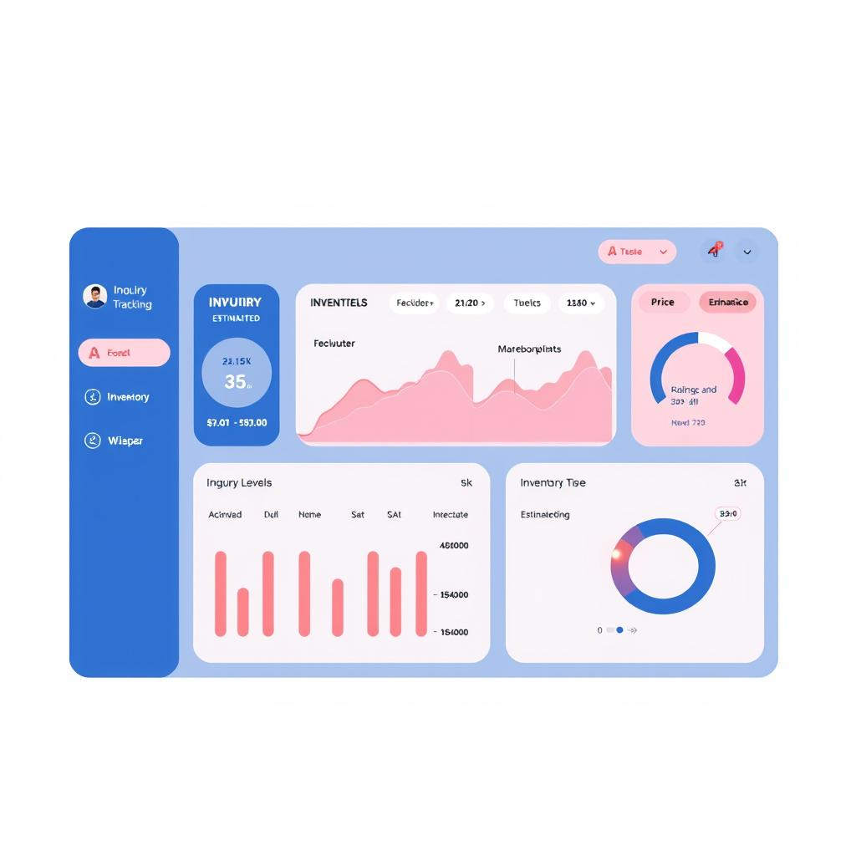
Phase-wise implementation
Phase 1 (CRM Application – Part 1)
Modules:
Enquiry Module – Capture & track all enquiries Follow-Up Module integrated with CRM for Inquiry tracking. Linked with ERP for client/order history. Client info, Inquiry details, response history. Follow-up status (mail sent, replied, closed). Response rates per follow-up stage. Conversion ratio from enquiries. Top reasons for lost enquiries.
Global Inventory Setup – Centralized multi-location inventory Vendor name, SKU, stock, lead time, pricing Technical certificates (MTC, compliance) Arrow ERP stock linked with vendor APIs ,emails/others Auto-sync inventory levels Auto-alert when Arrow Pipes stock low → check vendors Own stock + Vendor fallback option Attach MTC + Deviation sheet
Price Estimation Module – Automated quotations & costing

Slide 22
Phase-wise implementation
Phase 2 (Core CRM – Part 2)
Modules:
Follow-up Module – Automated reminders & client communication
Survey/Feedback Module – Collect & analyze customer insights

Slide 23
Team Roles and Responsibilities
Below details are the break down the specific roles and responsibilities of each team member involved in the project. It emphasizes the crucial role each individual plays in ensuring the project's success. Each role is likely paired with detailed tasks or responsibilities, highlighting how each contribution adds value to the overall goals of the project.
Role | Head Count | Responsibilities | Location
UI/UX Experts | 2 | Design and Storylines | Remotely
Front end developers | 4 | Web App Development | Remotely
AI Developers | 1 | AI Logics, Requirement Mappings with App | Remotely
Pl Sql Developer | 2 | Create Tables , Procedures, triggers | Remotely
Project Manager | 1 | End to End Delivery and Lead the Project | Hybrid
Business Analyst | 1 | Requirement Understanding | On Site
Manual Tester | 2 | Testing the quality of the web App | Remotely
Note – we are planning to deploy above team on the Project, but Team Members and Head count can be changed according to the availability.

Slide 24
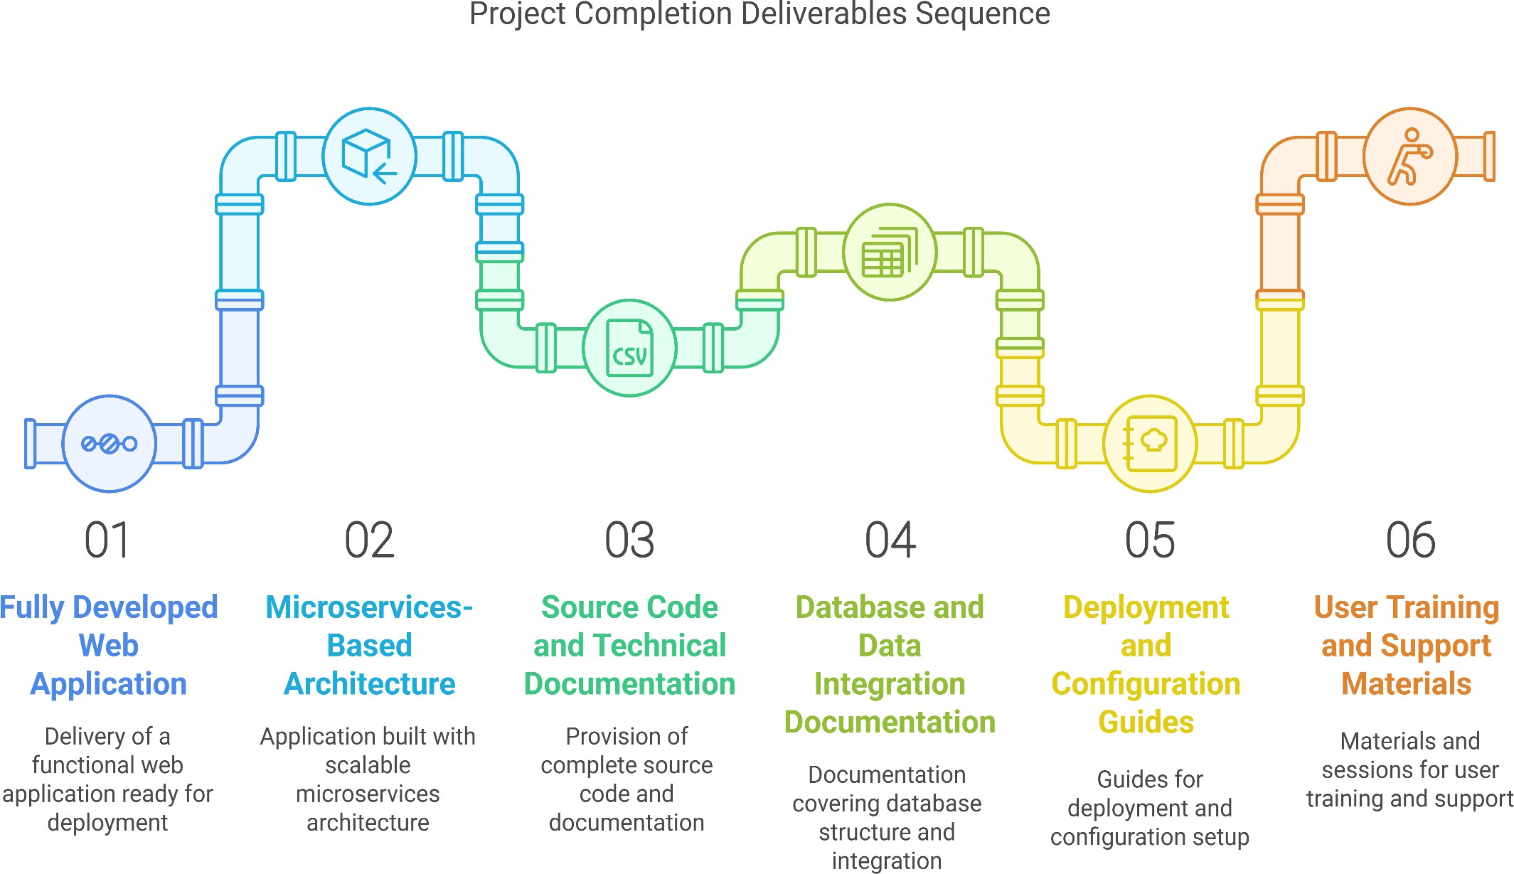
Project Deliverables Completion Funnel

Slide 25


Project Cost
We anticipate completing the project within 6 Months. Following that, we’ll dedicate an additional 1 months to thorough
bug fixing, drawing from both ongoing internal testing and external testing feedback, to ensure the highest quality and performance.
Sr. No. | Module Name
 | CRM Application including Frameworks
1 | Enquiry Module
2 | Global Inventory Setup
3 | Price Estimation Module
4 | Follow up Module
5 | Survey/Feedback Module
6 | Integrations with existing ERP & Security+ Cloud
Deployments | Application deployment across agreed environments
Additional Activity | 1 Month Free Support, Training, Documentation, and Source Code handover
Additional Activity | Data Migration (up to 15 days of effort)

